Slide 1
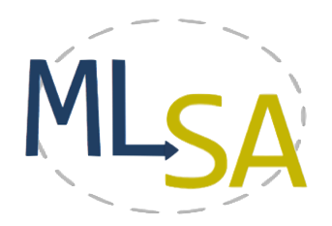
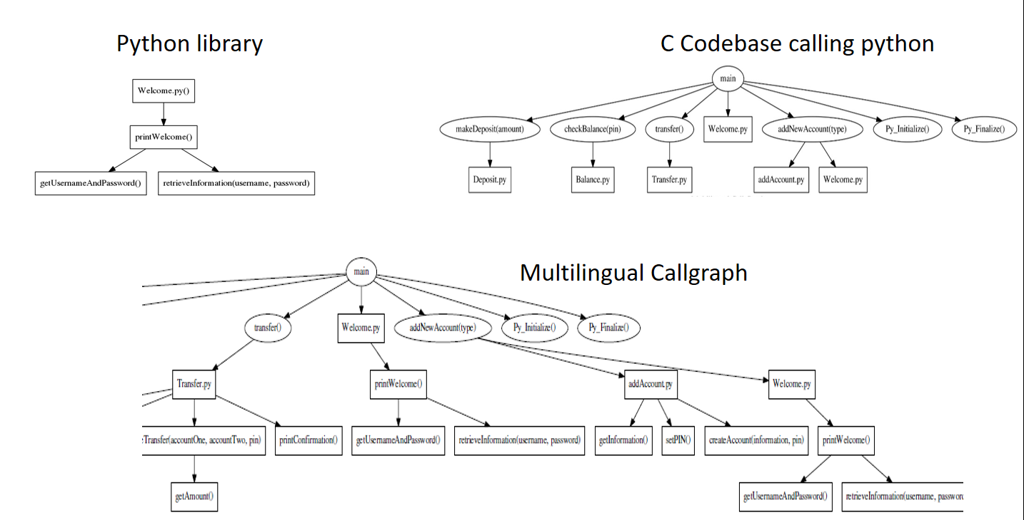
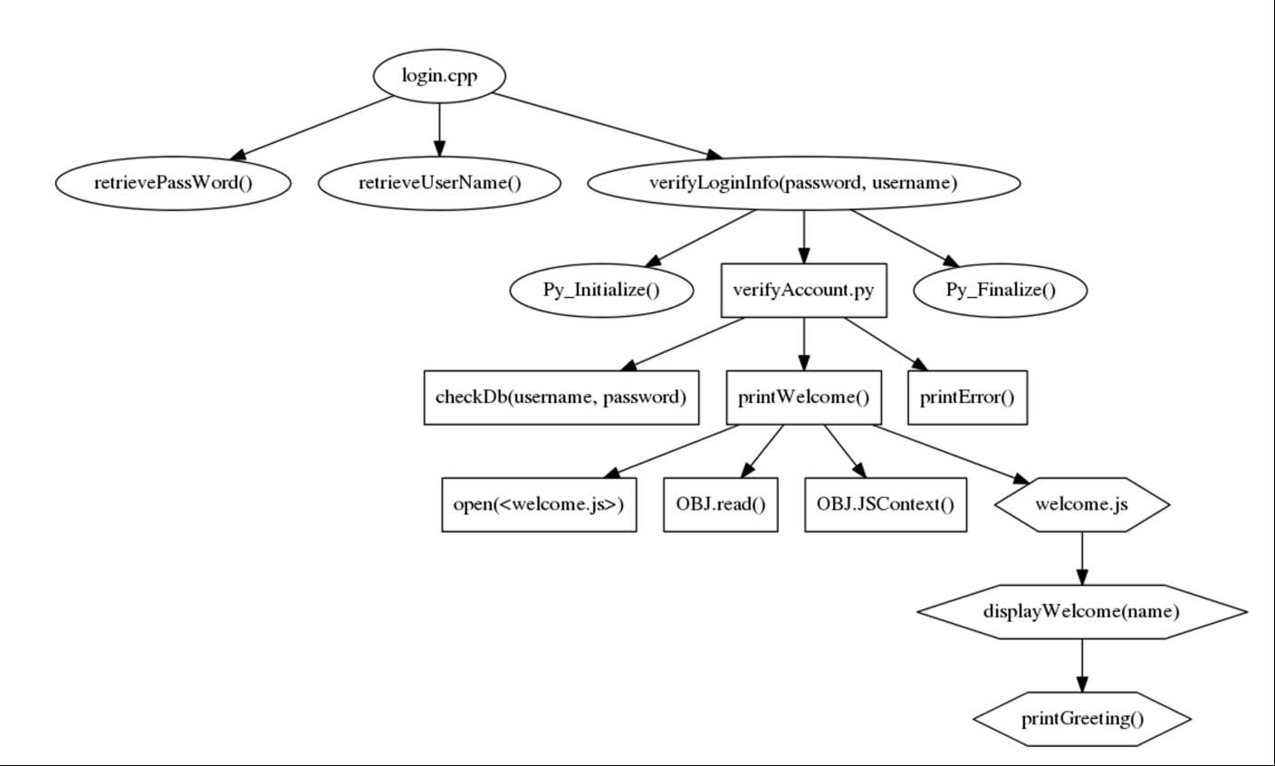
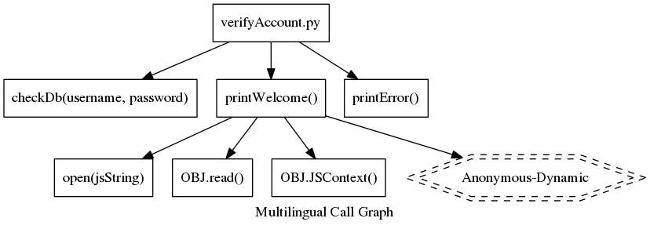
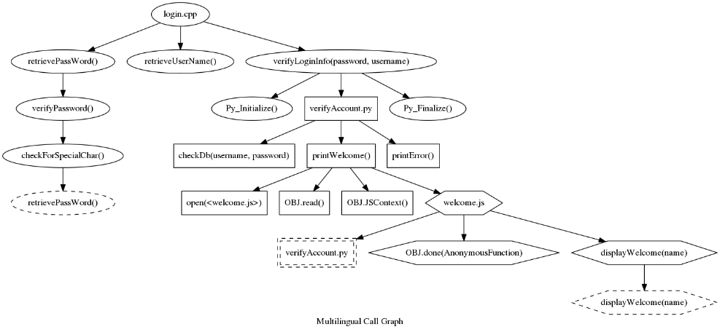
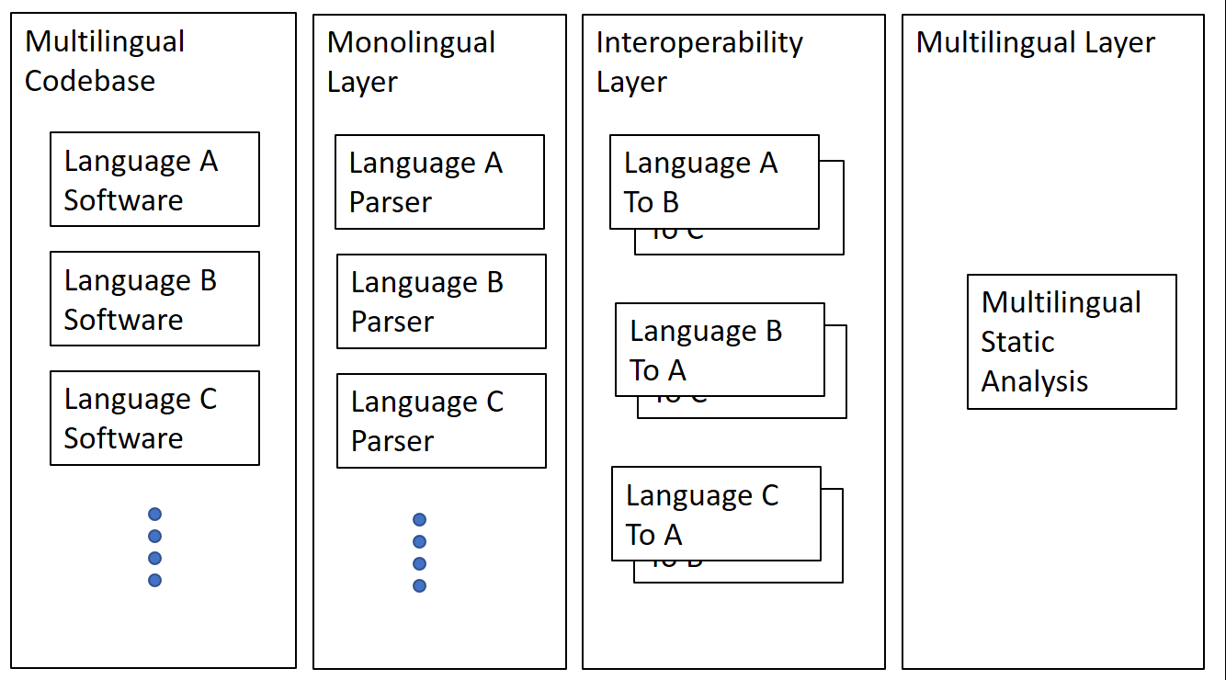
Multilingual Software Analysis
Damian M. Lyons¹, Anne Marie Bogar¹ and David Baird²
MLSA Research group
¹Department of Computer & Information Science, Fordham University, New York NY USA
²Bloomberg L.P., New York NY USA
{dlyons,abogar}@fordham.edu, dbaird16@bloomberg.net
Partially supported by grant DL-47359-15016 from Bloomberg L.P.
MOTIVATION
Companies with a large software base:
Have to manage software architectures and libraries
By different developers (in & out house)
Over many decades
In different languages
EXAMPLE
PROBLEM
A multilingual codebase gives rise to many software engineering issues at language boundaries, including
Redundancy
Debugging complexity
Security issues
Codebase with
multiple languages
in one call graph
Identifying Security Issues
BUT Multilingual will always be with us!
MLSA Research Group: .
Develop lightweight tools to process multilingual codebase into unified common representations such as
call graphs, flowgraphs, etc.
Statically unresolved call from Python to JavaScript
Multilingual Call Graph with Circularity
CONTACT
Looking for open-source collaboration
GitHub: https://git.io/MLSA
Email: multilingualSA@gmail.com
Twiki: https://goo.gl/6mvyNS
YouTube: https://goo.gl/g8ra15
Open Source, Lightweight Architecture
For Multilingual Software Analysis

